Slide 1

RISK MANAGEMENT
Subject: Project Management
Lecturer: Nguyễn Thanh Phước
Students: Huỳnh Phước Ngà_15130106
Nguyễn Hữu Tài_15130162

Slide 2
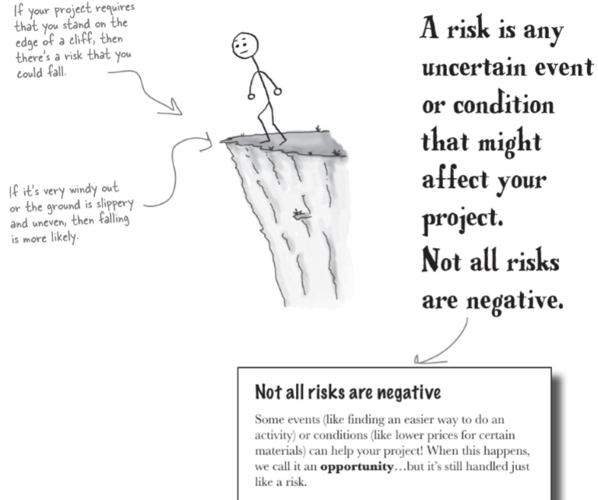
What’s a risk?
Any time there’s anything that might occur on your project and change the outcome of a project activity, we call that a risk. A risk can be an event (like a fire), or it can be a condition (like an important part being unavailable). Either way, it’s something that may or may not happen…but if it does, you will be forced to change the way you and your team work on the project.

Slide 3

How to deal with risk
When you’re planning your project, risks are still uncertain: they haven’t happened yet. But eventually, some of the risks that you plan for do happen. And that’s when you have to deal with them.

Slide 4
How to deal with risk
Five basic ways to handle a risk:
Avoid:
The best thing that you can do with a risk is avoid it—if you can prevent it from happening, it definitely won’t hurt your project.

Slide 5
How to deal with risk
Five basic ways to handle a risk:
Mitigate:
If you can’t avoid the risk, you can mitigate it. This means taking some sort of action that will cause it to do as little damage to your project as possible

Slide 6
How to deal with risk
Five basic ways to handle a risk:
Transfer:
One effective way to deal with a risk is to pay someone else to accept it for you. The most common way to do this is to buy insurance.

Slide 7
How to deal with risk
Five basic ways to handle a risk:
Accept:
When you can’t avoid, mitigate, or transfer a risk, then you have to accept it. But even when you accept a risk, at least you’ve looked at the alternatives and you know what will happen if it occurs.

Slide 8
How to deal with risk
Five basic ways to handle a risk:
Escalate:
If the risk is not in your project’s scope, you might need to tell somebody else about it to find an appropriate response.

Slide 9
Plan Risk Management
By the time a risk actually occurs on your project, it’s too late to do anything about it. That’s why you need to plan for risks from the beginning and keep coming back to do more planning throughout the project

Slide 10
The Risk Management plan is the only output
It tells you how you’re going to handle risk on your project—which you probably guessed, since that’s what management plans do. It says how you’ll assess risk on the project, who’s responsible for doing it, and how often you’ll do risk planning (since you’ll have to meet about risk planning with your team throughout the project).
Notes:
The plan has parts that are really useful for managing risk:

Slide 11
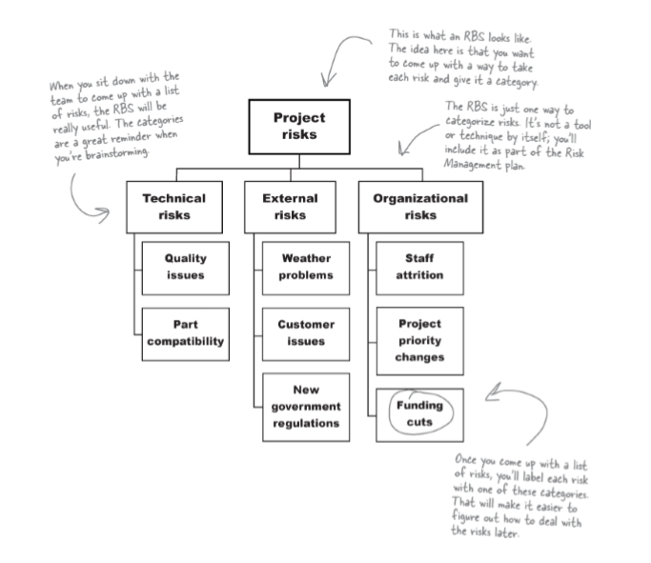
Use a risk breakdown structure to categorize risks
Concept:
You should build guidelines for risk categories into your Risk Management plan, and the easiest way to do that is to use a risk breakdown structure (RBS). Notice how it looks a lot like a WBS? It’s a similar idea—you come up with major risk categories, and then decompose them into more detailed ones.
Notes:
Cấu trúc phân chia rủi ro (RBS): là một mô tả tất cả câc rủi ro của dự án (được phân theo các nhóm rủi ro). Những rủi ro được đặt vào trong cấu trúc cây khi chúng được xác định, và cấu trúc cây được sắp xếp theo nguồn cơ. Do đó, chúng ta có thể dễ hiểu được tổng thể rủi ro của dự án và việc lập kế hoạch cho các rủi ro một cách dễ dàng hơn

Slide 12
Anatomy of a risk
Concept:
Once you’re done with Plan Risk Management, there are four more Risk Management processes that will help you and your team come up with the list of risks for your project, analyze how they could affect it, and plan how you and your team will respond if any of the risks materialize when you’re executing it.
Notes:
OUTPUT OF PLAN FOR RISK MANAGEMENT:
It tells you how you’re going to handle risk on your project—which you probably guessed, since that’s what management plans do. It says how you’ll assess risk on the project, who’s responsible for doing it, and how often you’ll do risk planning (since you’ll have to meet about risk planning with your team throughout the project).

Slide 13
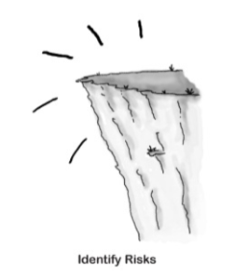
Anatomy of a risk
Four processes for Risk Management
Identity Risks
The first thing you need to do when planning for risks is to gather the team together and come up with a list of every possible risk you can think of.
Notes:
Addition : The RBS you created during Plan Risk Management will make it a lot easier to do this.

Slide 14
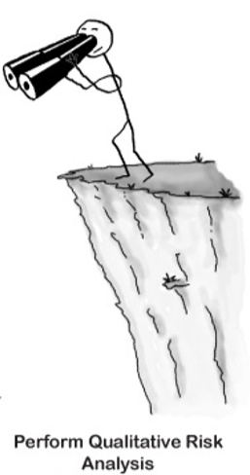
Anatomy of a risk
Four processes for Risk Management
Perform Qualitative Risk Analysis
One you're got a list of risks, you'll need to get a good idea of the probability and impact of each risk
Notes:
Remember the probability(xác xuất) and impact(khả năng tương tác) guidelines in the Risk Management plan? This is where you use them to assign a probability and impact to each risk.

Slide 15
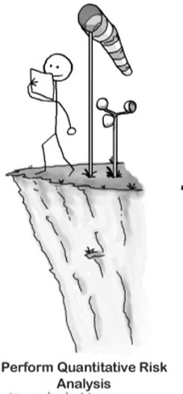
Anatomy of a risk
Four processes for Risk Management
Perform Qualitative Risk Analysis
You can make better decision with more precise data. That’s what this process is about-assigning numerical values for the probability and impact of each risk.
Notes:
Probability:Xác xuất(khả năng)
Impact: sự tác động

Slide 16
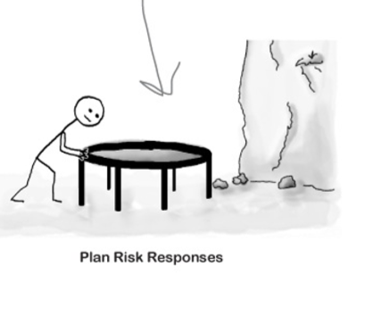
Anatomy of a risk
Four processes for Risk Management
Plan risk responses:
All that's left now is to plan responses to each risk, this is where you decide whether to avoid, mitigate, transfer, or accept… and how you’ll to do it!
Notes:
*All four of these Risk Management processes are in the Planning process group—you need to plan for your project’s risks before you start executing the project.

Slide 17
Identify Risks
Why must identify the risk?
How to do it?

Slide 18
What could happen to your project?
Why must identify the risk?
You can’t plan for risks until you’ve figured out which ones you’re likely to run into.
Notes:
The idea is that you want to figure out every possible risk that might affect your project. Don’t worry about how unlikely the risk is, or how bad the impact would be—you’ll figure that stuff out later.

Slide 19
Techniques to identify the risk
Data-gathering techniques for Identify Risks
The most important way to identify those risks is to gather data from the team, stakeholders, and anyone else who might have data on risks.
Notes:
Gathering data from team, stakeholders, and anyone else who might have data on risks.
the first—and most important—technique in Identify Risks is called data-gathering techniques.(Kỹ thuật quan trọng đầu tiên trong việc xác định risk là data-gathering techniques

Slide 20
Techniques to identify the risk
Data-gathering techniques for Identify Risks:
Useful data gathering techniques:
Brainstorming is the first thing you should do with your team. Get them all together in a room, and start pumping out ideas. Brainstorming sessions always have a facilitator to lead the team and help turn their ideas into a list of risks.
Notes:
Là công việc đầu tiên mà bạn nên thực hiện với team của bạn, tập hợp tất cả các thành viên trog team lại với nhau sau đó các thành viên sẽ đưa ra các ý tưởng. Và các buổi brainstorming luôn luôn có một người hỗ trợ việc dẫn dắt team và giúp biến các ý tưởng của họ thành danh sách các risk.
Note: The facilitator is really important—without her, it’s just a disorderly(rối loạn) meeting with no clear goal.

Slide 21
Techniques to identify the risk
Data-gathering techniques for Identify Risks:
Useful data gathering techniques:
Interviews are a really important part of identifying risk. Try to find everyone who might have an opinion and ask them about what could cause trouble on the project. The sponsor or client will think about the project in a very different way than the project team
Notes:
Là một phần quan trọng trong việc identifying the risk, cố gắn tìm những người có quan điểm(or ý kiến) riêng về risk sau đó hỏi họ về những gì có thể là nguyên nhân gây ra rắc rối cho dự án, người tài trợ cho dự án or khách hang sẽ có cách nghĩ về dự án rất khác so với team trong dự án.
Note: The team usually comes up with risks that have to do with building the product, while the sponsor or someone who would use the product will think about how it could end up being difficult to use.

Slide 22
Techniques to identify the risk
Data-gathering techniques for Identify Risks:
Useful data gathering techniques:
Checklist analysis means using checklists that you developed specifically to help you find risks. Your checklist might remind you to check certain assumptions, talk to certain people, or review documents you might have overlooked
Notes:
Sử dụng các checklist đó đã được được bạn phát triển theo cách cụ thể để giúp trong việc tìm ra các risk trong dự án. Checklist của bạn có thể giúp bạn kiểm tra các giá trị giả định nhất định, nói chuyện với một số người hoặc xem lại các tài liệu có thể bạn đã bỏ qua.
Workbreakdown structure mà bạn đã tạo trong Risk Plan Management là nơi tốt nhất để bắt đầu cho checklist

Slide 23
Techniques to identify the risk
More Identify Risks Techniques:
Even though gathering data is the biggest part of Identify Risks, it’s not the only part of it. There are other tools and techniques that you’ll use to make sure that the risk register you put together lists as many risks as possible.
Notes:
Mặc dù việc thu thập dữ liệu (Gathering data) là phần lớn nhất(chủ yếu) trong việc xác định rủi ro, nhưng nó không phải là một phần duy nhất của nó, có một số tool và kỹ thuật mà bạn có thể sử dụng để đảm bảo rằng bạn tìm được một danh sách các rủi ro được đặt cùng nhau có càng nhiều rủi ro càng tốt. Vì khi bạn biết được nhiều rủi ro có thể xảy ra bên trong dự án của bạn thì bạn có thể xử lý được những bất ngờ mà chúng đem lại trong dự án của bạn

Slide 24
Techniques to identify the risk
Data analysis tools and techniques :
Document analysis
Root-cause identification
SWOT analysis
Assumptions and constraint analysis
Notes:
*Phân tích document: is when you look at plans, requirements, documents from your organizational process assets, and any other relevant documents that you can find to squeeze every possible risk out of them.
*Xác định nguyên nhân chính
*Phân tích sự làm việc chăm chỉ: Cho phép bạn phân tích điểm mạnh, yếu, cơ hội và mối đe dọa. Bạn sẽ bắt đầu việc phân tích điểm mạnh, yếu, sau đó bạn kiểm tra các điểm mạnh để tìm ra các cơ hội và điểm yếu để xác định mối đe dọa đối với dự án.
*Giả định và phân tích các rang buộc:

Slide 25
Techniques to identify the risk
Data analysis tools and techniques :
Interpersonal and team skills
Prompt lists
Expert judgment
Meetings
Notes:
*Kỹ năng giao tiếp và nhóm: giúp cho team của bạn tham gia rộng rãi trong việc xác định rủi ro của dự án
*Danh sách các nhác nhở: là việc sửa dụng danh sách các danh mục rủi ro, giúp bạn và team sử dụng nhằm mục đích khơi gợi những suy nghĩ lại khi xác định rủi ro.
*Tham khảo chuyên gia
*Meeting: mở cuộc họp giúp bạn và team bạn xác định các rủi ro

Slide 26
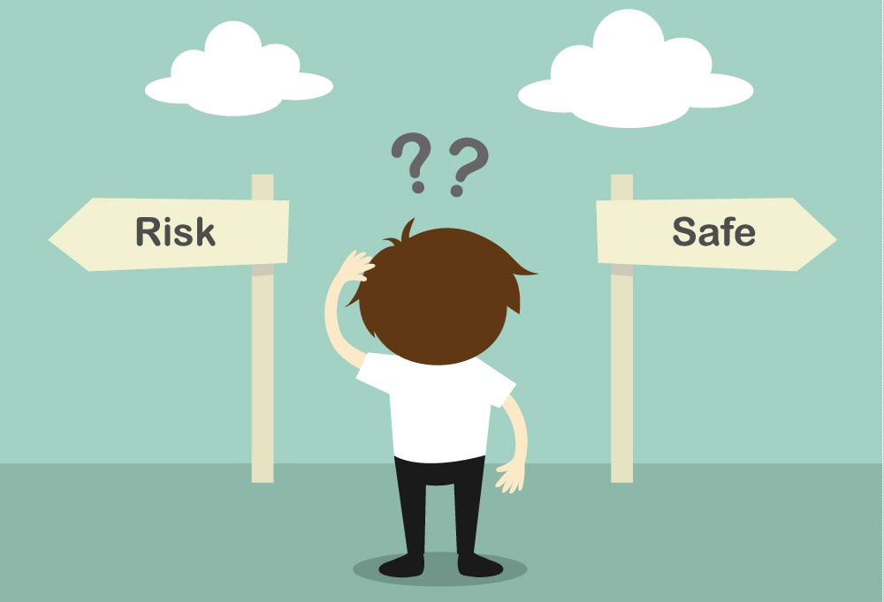
Where to look for risks
Resources are a good place to start
The critical path is full of risks
When you assume
Look outside your project

Slide 27
Rank your risks
There’s really no limit to the number of risks you can think of.
Some risks will cause a whole lot of damage to your project if they happen, while others will barely make a scratch.
You care much more about the risks that will have a big impact.

Slide 28

Calculate the expected monetary value of your risks
How does that really help you plan?
It turns out that if you have good numbers for those things, you can actually figure out how much those risks are going to cost your project.

Slide 29
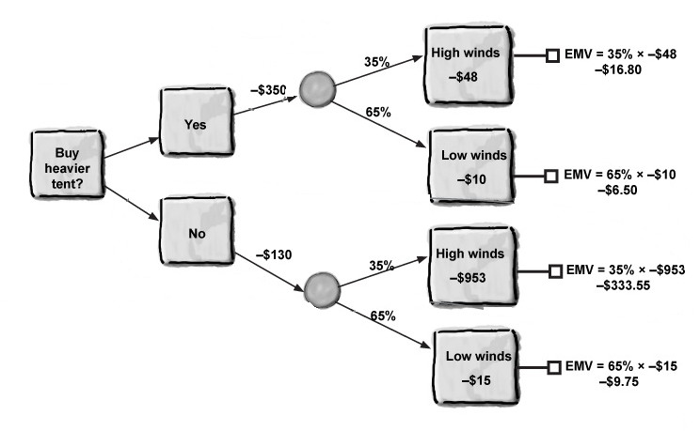
Decision tree analysis uses EMV to help you make choices
Notes:
Expected Monetary Value (EMV) : giá trị tiền tệ dự kiến.
Visually : Trực quan

Slide 30
What type of tent you choose?
Cost $350
Cost $130

Slide 31
The “real” cost
Cost $350
Choosing heavier tent:
-$16.80 + (-$6.50) + (-$350) = -$373.30
Choosing “cheaper” tent:
-$130 + (-$333.55) + (-$9.75) = -$473.30
→ Cheaper tent more expensive !
Cost $130

Slide 32
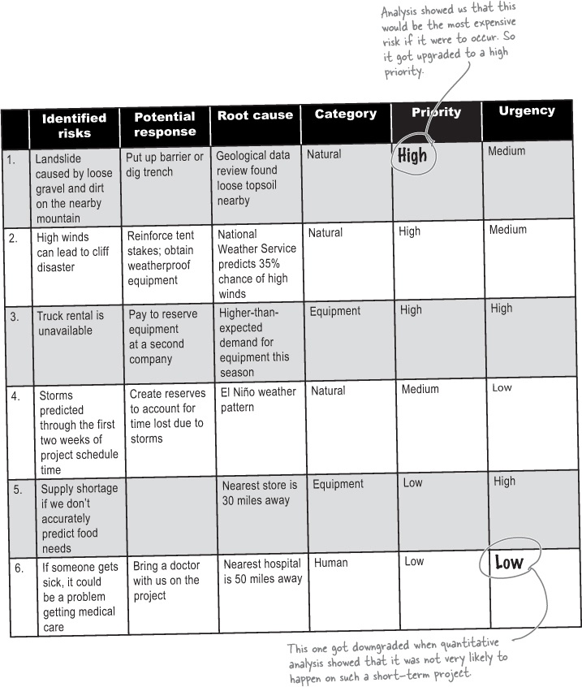
Update the risk register based on your quantitative analysis results
When you’ve finished gathering data about the risks, you change your priorities, urgency ratings, and categories (if necessary), and you update your risk register.

Slide 33
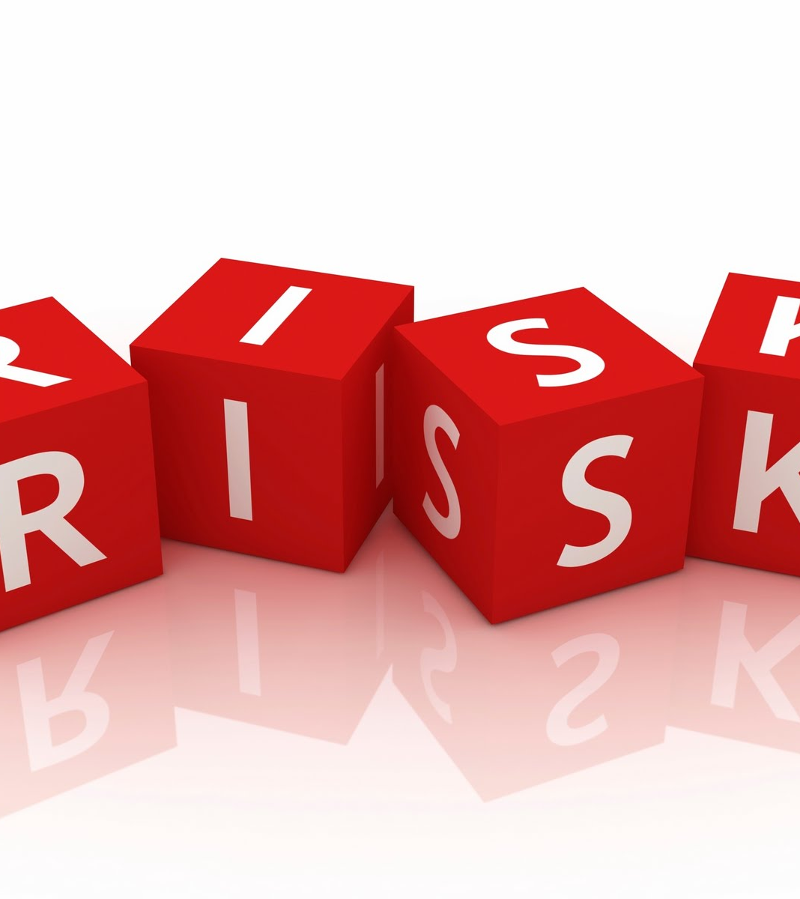
How do you respond to a risk?
Expert judgment
Contingent response strategies
Data gathering: interviews
Decision making
Interpersonal and team skills: facilitation
Data analysis: alternatives analysis and cost-benefit analysis
Notes:
Plan Risk Responses is figuring out what you’ll do if risks happen.
Contingency plans : Kế hoạch dự phòng.
Contingent response strategies : Chiến lược phản ứng ngẫu nhiên
Interviews with stakeholders not team member

Slide 34
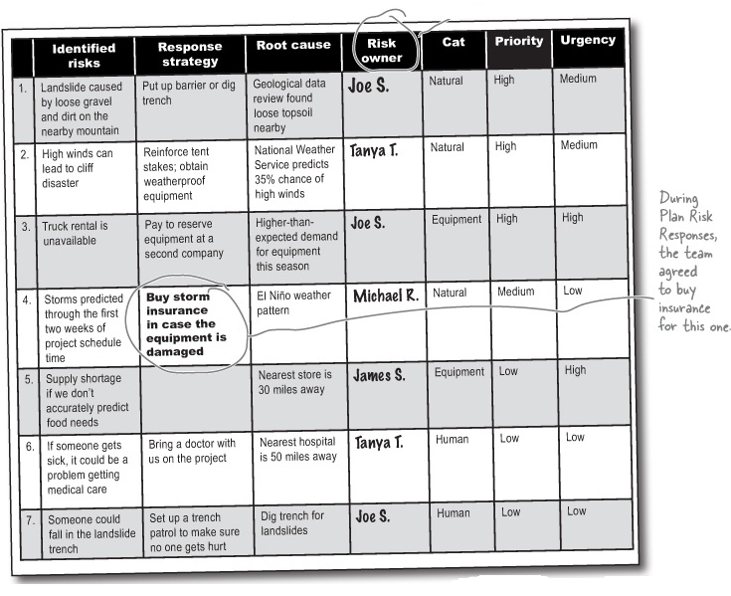
Add risk responses to the register

Slide 35

Implement Risk Responses
All about what you do when you run into an occurrence of the risks you’ve identified.
This is where you actually respond to the risk by doing what’s in your plan.

Slide 36
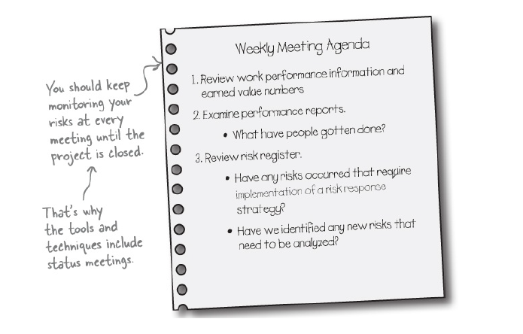
Monitor Risks is another change control process
Risk responses are treated just like changes. You monitor the project in every status meeting to see how the risks in the risk register are affecting it. If you need to implement a risk response, you take it to your change control board, because it amounts to a change that will affect your project constraints.

Slide 37
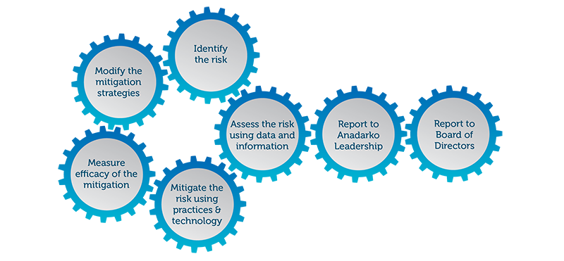
Risk monitoring
Monitoring risks means keeping your finger on the pulse of the project.
Notes:
Keeping your finger on the pulse : Hiểu tường tận

Slide 38

How to monitor your risks
Technical performance analysis
Reserve analysis

Slide 39

More control risk tools and techniques
Audits are when you have an outside party come in and take a look at your risk response strategies to judge how effective they are.
Meetings are the most important way to keep the team up to date on risk.

Slide 40

THANK YOU!

